Slide 1
Capstone Project
Battle of the Neighborhoods
Exploring Suburban Areas of Houston
Destiny Lindhardt

Slide 2
Introduction
"Location, location, location" is applicable to the business world as well. Location has the potential to be the deciding factor in whether a business succeeds or fails.
Suburban areas in the West Houston will be the focal point of this project. Factors that will be considered include
The number of other restaurants in each suburban area
Other venues in the suburban area that might attract restaurant patrons (movie theaters, shopping centers, etc.)
Target Audience
Entrepreneurs
Investors
Lending Institutions

Slide 3
Data Acquisition and Cleaning
Location data acquired through usage of Foursquare API
From location data, category and coordinates of the venues were filtered.
Venues containing “restaurant” in category name were extracted, transferred to dataframe and plotted on a map.
Above step was repeated for movie theaters, hotels, shops/stores, and beauty services. These categories will be referred to as “other venues”

Slide 4
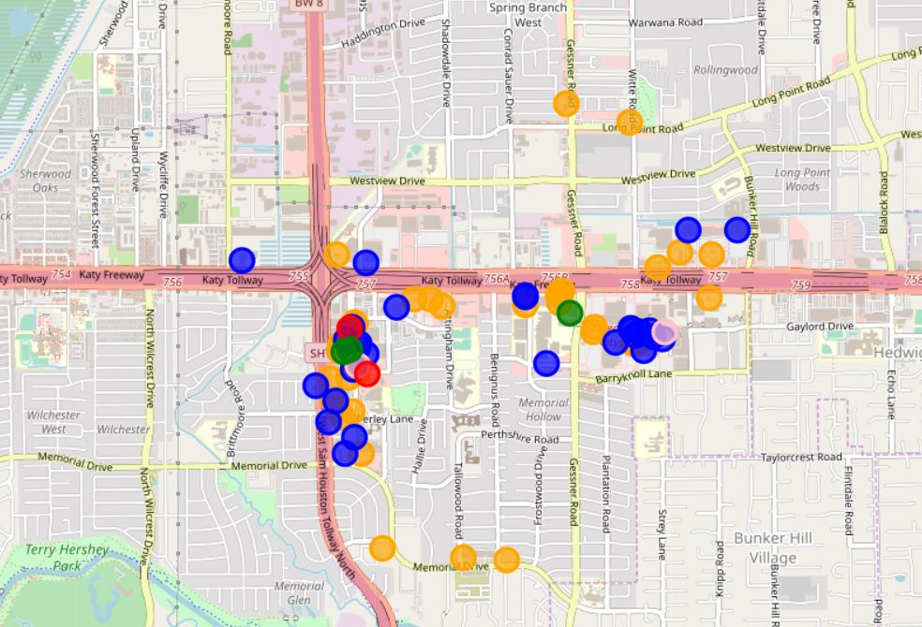
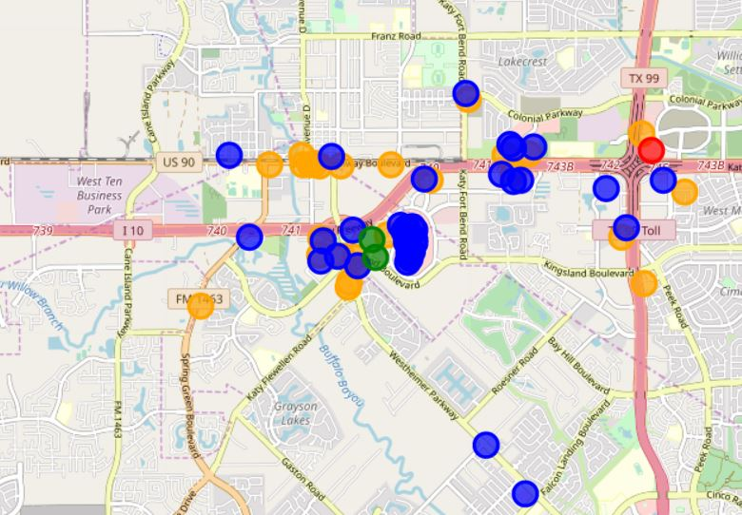
Memorial City
Legend
Orange = Restaurant
Blue = Store/Shop
Pink = Beauty Service
Red = Movie Theater
Green = Hotel
Katy

Slide 5
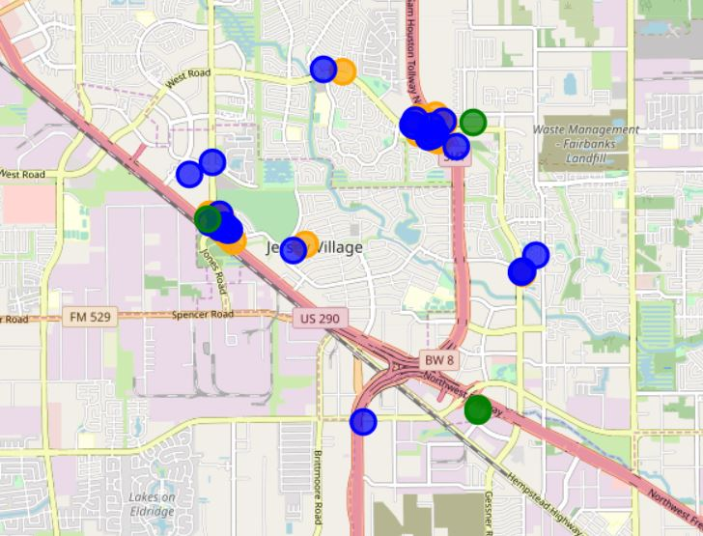
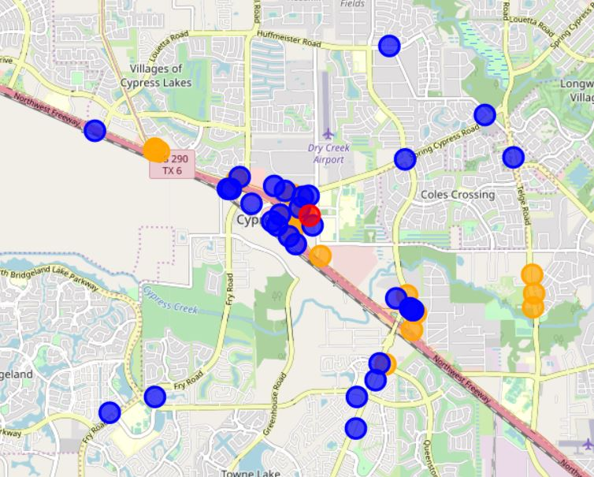
Jersey Village
Legend
Orange = Restaurant
Blue = Store/Shop
Pink = Beauty Service
Red = Movie Theater
Green = Hotel
Cypress

Slide 6
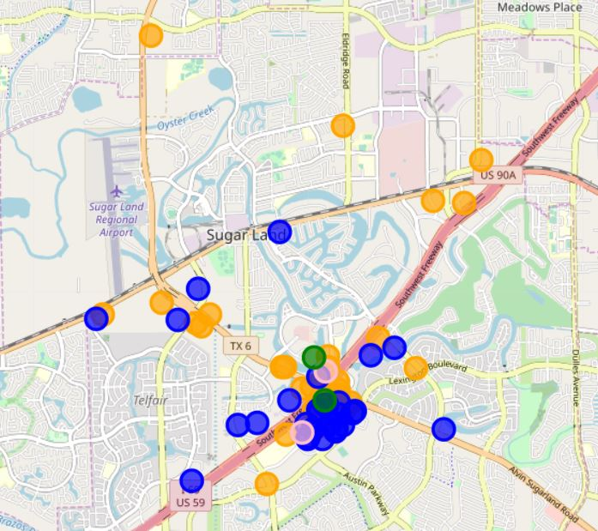
Sugar Land
Legend
Orange = Restaurant
Blue = Store/Shop
Pink = Beauty Service
Red = Movie Theater
Green = Hotel

Slide 7
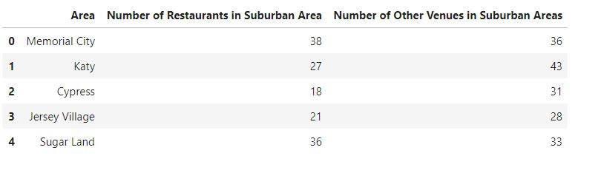
Summarized Data

Slide 8
Results and Conclusion
Few venues of any type in Jersey Village
Katy has many “other venues” but they are also crowded with several restaurants.
Memorial City and Sugar Land have highest number of restaurants and “other venues”, indicating possibility of high competition.
Cypress has several “other venues” uncrowded by restaurants and also the fewest restaurants out of all five suburban areas, meaning this would be the best suburban area in West Houston to open a restaurant.

Slide 9
Future Improvements
Instead of limiting restaurants to venues that have the word “restaurant” in their category, expand it to venues that are “bars” or “burger joints” or “steakhouses”
Factor in tips and user reviews from Foursquare data to determine popular areas of town for potential new businesses.

